Slide 1

Software Development of Salary Calculation for different positions in the company «X»
Team Nr.3
//Marija Borisova & Anita Vlasova//

Slide 2
AIM
To develop the application, which could keep tracking the employees’ worked hours and, based on the wage rate, calculate the salary, taking on account taxes and additional conditions for calculation. The application should also be able to build the report by period and salary for all the employees.

Slide 3
Project Tasks
1
To store information, we will use sql files (the data will be taken from SQL database (SSMS), which can be changed - name, employee position, hours worked, etc.).
2
It will be necessary to input the number of days worked in relation to the period (date, month, year), the number of hours worked, the number of overtime hours, the gross rate according to the contract, indicate whether the e-tax book was accepted or not and the number of dependents. After entering the data by the user/manager, the tax calculation and the net salary result would be completed in the requested reports.
3
In the application will be used three types of positions for comparison (objects): manager and employee with a fixed salary under the contract; the freelancer to whom the hourly wage applies. In this case, there is no authorization, i.e. hours are input by the manager on the basis of approved and worked schedules.

Slide 4
4
The interface has been built using MVC software design pattern.
5
In the development of application SQL server and SSMS software have been used.
6
The GIT version control system has been used to record intermediate results during the application developing. There were comments on commits as well.

Slide 5
Project Tasks
1
Can add employees in the database with the role of manager, employee on fixed salary, employee on hourly salary.
2
Can edit employees in the database with the role of manager, employee on fixed salary, employee on hourly salary.
3
Has the right to view the report for the selected period for all employees (periods can be per day, per week, per month) Can view worked for the selected period for a specific employee.
APPLICATION FUNCTIONALITY.
OBJECTS.
MANAGER.a
sks

Slide 6
Examples of the reports
For Employees
For the Concrete employee
Report for the period from [start date] to [end date]
---------------------------------------------------------------------
Jānis Bērziņš worked [n] hours and earned for the period [gross amount] EUR, the total tax sum is [employee social and income tax] EUR. The net sum is []EUR. The total amount of expenses [all the taxes and gross amount] EUR.
---------------------------------------------------------------------
Andris Ozols worked [n] hours and earned for the period [gross amount] EUR, the total tax sum is [employee social and income tax] EUR. The net sum is []EUR. The total amount of expenses [all the taxes and gross amount] EUR.
--------------------------------------------------------------------
Would you like to see another report? Press (Y)es to continue. (N)o to go to the main screen of the program.
Employee report: [Employee name] for the period from [start date] to [end date]
01.06.2021, 8 hours
02.06.2021, 8 hours
03.06.2021, 10 hours
Total: 26 hours, the net sum: 2000 EUR
The total amount of expenses [all the taxes and gross amount] EUR.

Slide 7
Project Tasks
1
The user could input the gross salary and taking an account the taxes, the net salary will be calculated.
APPLICATION FUNCTIONALITY.
OBJECTS.
NET SALARY
CALCULATOR.
Nsks

Slide 8
Project Tasks
1
Can view his hours worked and salary for the period.
APPLICATION FUNCTIONALITY.
OBJECTS.
FREELANCER HOURLY RATE.
Freelancer’s properties:
Monthly Salary: no monthly salary, worked hourly rate- 16,5 gross EUR/h.
No overtime paid additionally.
Nsks

Slide 9
Project Tasks
1
The data will be entered into sql file (the database will be used).
2
An example of information from a file with a list of hours worked by employees:
3
The list of employees will look like this:
07/01/2021, surname, 8 //worked hours
Surname, employee // fixed rate
Surname, manager // manager
Surname, employee hourly rate // hourly rate.
PROJECT STRUCTURE.
Technical points.
Information saving will be arranged by the following way (4 files):
1. List of employees;
2. List of manager worked hours;
3. List of worked hours by employees’ with the fix rate
4. List of worked hours by freelancers’ with the hourly rate
Nsks

Slide 10
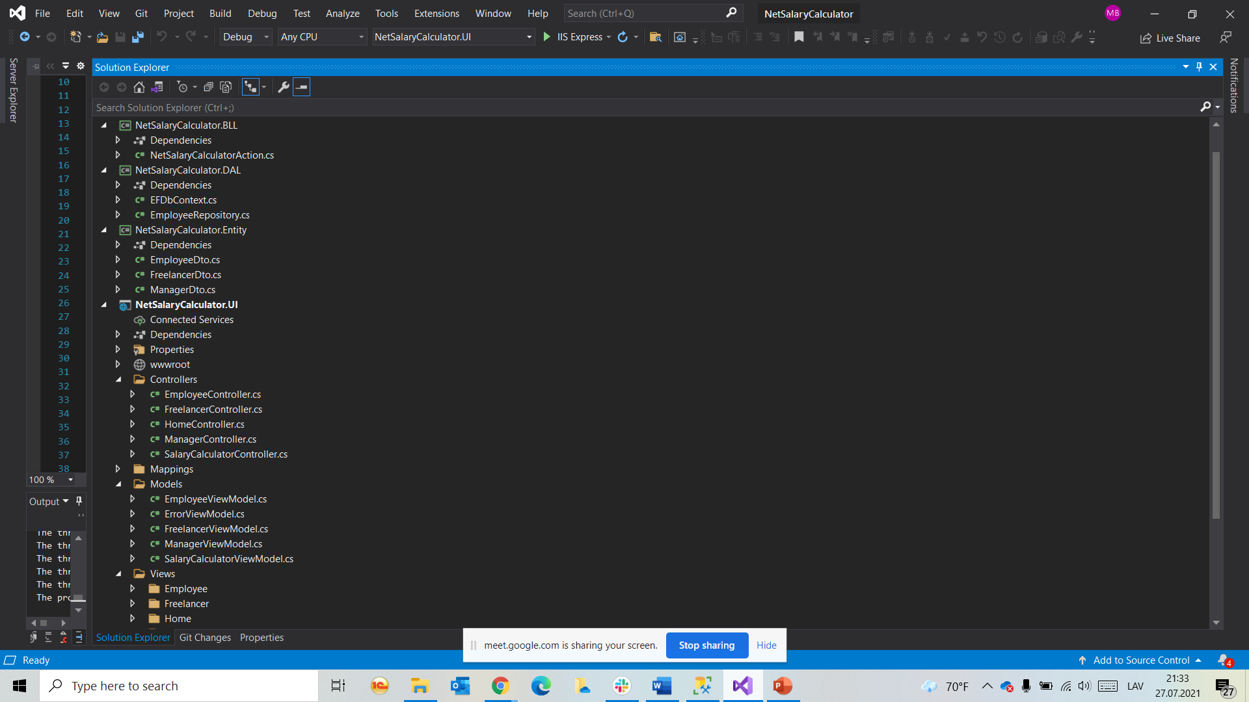
The structure of the project is:

Slide 11
The structure of the project is:
The classes (Class Library) for all the main modules of our project were created (NetSalaryCalculator.BLL (business logic); NetSalaryCalculator.DAL (database/repository and connections with SQL server); NetSalaryCalculator.Entity (objects with their properties); NetSalaryCalculator.UI (API.NET MVC model with Models, Controllers and Views patterns)
MVC UI in which all should be connected for input of the necessary result
Set dependencies between classes.
Repository- is for saving of the data base, which consists of the files (*.sql)

Slide 12
Thank you for attention!
Please, your questions.

Slide 13
SEE YOU IN THE BOOTCAMP MODUL! ☺

